Slide 1

SEND Information Report
This is our Special Educational Needs and Disability Information Report.
It explains what we can offer to our children at Shardlow Primary School.
Contact Us
Meet the Team
What is the SEND Information Report about?
SEND provision at our Primary School
What does this mean?
My Child’s Progress
Partnership with Parents
Outside Agency Work
Shardlow Primary School Information report

Slide 2

How will I know if my child is receiving SEND support? Will I receive information about this support?
Do children with SEND come to Shardlow School?
What process does the school follow once SEND has been identified?
What kind of SEND does the school make provision for?
How are children with SEND supported in school?
SEND PROVISION AT
SHARDLOW PRIMARY SCHOOL
What do I do if I think my child needs additional support / referral / diagnosis?
How do you help class teachers to support children with SEND?
How does the school know if a child has SEND?
How does the school support emotional and social development?

Slide 3
We are an inclusive school and we follow the guidelines from the Revised Code of Practice, April 2015. Click here for more information.
We ensure that all of our children are included in all aspects of learning and school life from the Reception Year all the way to Year Six.
From time to time some children will require additional support for a period of a few weeks, months or even longer to meet their needs. These children may have additional support through targeted intervention work. If a child’s needs persist, then the child may be identified as having special educational needs or disabilities (SEND). This will be discussed between parents / carers, the child (if appropriate) and the class teacher. Following this the child will be placed on the SEND support register. The Code of Practice defines children with SEN as, “ Any child who receives any support which is additional to or different from everyday practice and / or receives support from outside agencies”. The decision to do this is made by the school after consultation with the parents and is based on each child’s individual needs.
This SEND Information Report describes the provision we offer and the support available.

Slide 4

We would like you to get in touch!
Do you have suggestions about how we can improve our service to you?
Is there a topic you would like to know more about?
Can you recommend places where you take your child with SEND that you have enjoyed?
Please contact: headteacher@shardlow.derbyshire.sch.uk

Slide 5
Family Liaison Officer
Teachers
SENDCO
Headteacher
External Agencies
SEND Governor
Contact Us

Slide 6
Our SENDCO – (Special Educational Needs & Disabilities Co-ordinator) is Mrs Berry
The key responsibilities of the SENDCO may include:
• overseeing the day-to-day operation of the school’s SEND policy
• co-ordinating provision for children with SEND
• liaising with the relevant Designated Teacher where a looked after pupil has SEND
• advising teaching and support staff on SEND support
• liaising with parents / carers of pupils with SEND
• liaising with early years providers, other schools, educational psychologists, health and social care professionals, and independent or voluntary bodies
• being a key point of contact with external agencies, especially the local authority and its support services
• liaising with potential next providers of education to ensure a pupil and their parents / carer are informed about options and a smooth transition is planned
• working with the Headteacher and school governors to ensure that the school meets its responsibilities under the Equality Act (2010) with regard to reasonable adjustments and access arrangements
• ensuring that the school keeps the records of all pupils with SEND up to date

Slide 7
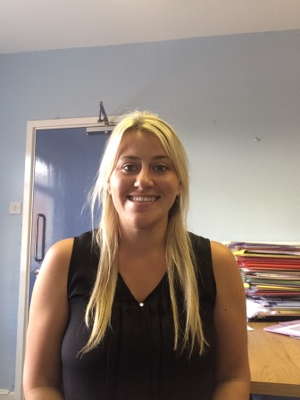
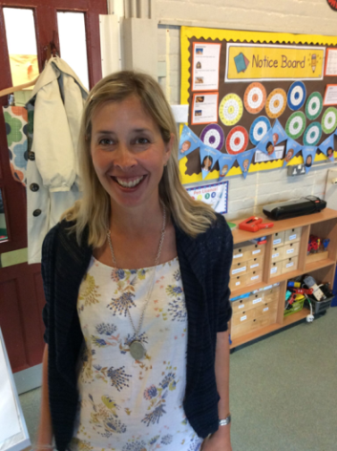
Mrs Berry is our Head of School and SENDCO
(Special Educational Needs and Disabilities Coordinator)
Mrs Magner is our Headteacher
They are responsible for:
The day to day management of all aspects of the school, this includes the support for children with SEND.
They will give responsibility to the class teachers but are still responsible for ensuring that your child's needs are met.
They must make sure that the Governing Body is kept up to date about any issues in the school relating to SEND.
Alongside the Governing Body the Headteacher has responsibility for allocating the SEND budget.

Slide 8
Our SEND Governor is responsible for:
Making sure that the necessary support is made for any child who attends the school who has SEND.
Alongside the Headteacher they have responsibility for allocating the SEND budget.
If you would like to contact our SEND Governor please contact the school office on 01332 792215.

Slide 9
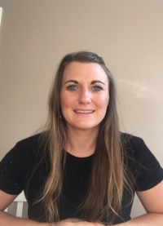
Family Liaison Officer (F.L.O.)
Claire Kudryk is the F.L.O. for One Academy Trust and is based at Shardlow half a day a week. Claire is available to support you and your child with establishing positive behaviour routines or helping with concerns such as anxiety or bereavement.
If you would like to request a meeting, please either speak with your child’s class teacher, the SENDCO, or you can contact her directly on ckudryk@oneacademytrust.co.uk.

Slide 10
Do children with SEND (Special Educational Needs and Disabilities) come to Shardlow Primary School?
SEND PROVISION AT SHARDLOW
PRIMARY SCHOOL
We are a mainstream school and the majority of our pupils are expected to reach the learning goals for their age. A small number of our pupils do have special educational needs and / or disabilities. We identify a child as having SEND if they receive any support which is additional to or different from everyday practice and / or receive support from outside agencies.
We have a SEND policy in place to support these children. Other policies may also apply, depending on need.

Slide 11

External Agencies
We work very closely with a number of external agencies and professionals. The people we work with most often are:
EPS – Educational Psychology Service
SALT – Speech and Language Therapy
OT / PT/ PI – Occupational Therapy / Physiotherapy/ Physical Impairment
CAMHS – Children and Adolescent Mental Health Service
Teacher of the deaf
Inclusion Support Advisory Service (previously known as: SSSEN – Support Service for Special Educational Needs, AO – Autism Outreach, BSS- Behaviour Support Service)

Slide 12

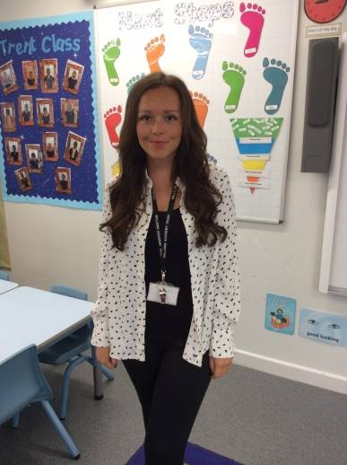
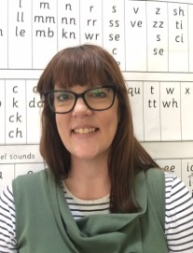
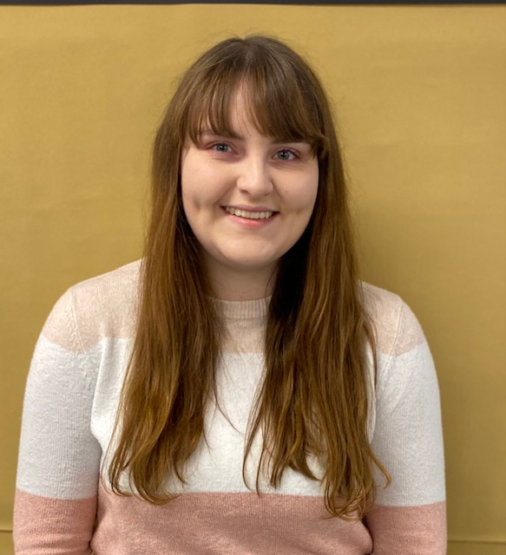
Class Teachers:
Mrs. Molyneaux – Reception
Mrs. Peach- Years 1 and 2
Mrs. Campbell- Years 3 and 4
Mr. Dale- Years 5 and 6
Teachers are responsible and accountable for the progress and development of all the pupils in their class, including where pupils access support from teaching assistants or specialist staff.
High quality teaching, adapted to accommodate individual pupils, is the first step in responding to pupils who have or may have SEND.
If a teacher has ongoing concerns about a child’s progress, they will liaise with the SENDCO who will offer advice and support.
If the SENDCO and class teacher feel that SEND support is required, this will be discussed with parents / carers and the child will be placed on the school’s SEND Support Register.
The class teacher is the first point of contact for parents / carers who may have concerns / questions about their child’s progress. If you would like to contact your child’s class teacher, please phone or email the school office enquiries@shardlow.derbyshire.sch.uk
Mr. Dale Mrs. Molyneux Mrs. Peach Mrs. Campbell

Slide 13
How does the school know if a child has SEND
(Special Educational Needs or Disability)?
SEND PROVISION AT OUR
PRIMARY SCHOOL
Our Class Teachers closely monitor the progress made by all children in their class and ask advice from the SENDCO (Special Educational Needs and Disabilities Co-ordinator) as soon as they have concerns about any of their pupils. The SENDCO may then suggest activities such as small group work or special intervention programmes to help the child. If the child continues to have difficulties, the SENDCO and class teacher would suggest additional support and / or assessment. At this point, the child may be placed on the SEND Support Register after consultation with parents / carers.

Slide 14
How does the school support pupils’ social, mental and emotional health and development?
SEND PROVISION AT SHARDLOW
PRIMARY SCHOOL
Each class teacher teaches PSHE (Personal, Social and Health Education) in class so that children have time to consider, reflect and discuss a range of issues and topics so that they develop knowledge and skills to live happy and healthy lives. We also have buddy system at playtimes for children who feel lonely, and for new children starting at school.
Our Family Liaison Officer, Claire Kudryk, is available to support children and their families with issues such as challenging behaviour, bereavement etc.
For children with specific social, mental or emotional health difficulties we work with the EPS (Educational Psychologist Service), and can help signpost to other services such as CAMHS (Children and Adolescent Mental Health Service).

Slide 15
What process does the school follow
once SEND has been identified?
Step 1: Class Teacher, SENDCO and Parents / Carers make the joint decision to place the child on the SEND Support Register.
Step 2: Individual targets and strategies / interventions are identified and put into place.
Step 3: These are reviewed at termly meetings with parents / carers, following the SEN Code of Practice 2015 format of Assess, Plan, Do and Review. External agencies may be involved for support and / or assessment where required.
Step 4: Where children have very complex needs and / or despite the school having taken relevant and purposeful action to support the child, if the child does not make expected progress, the school or parents may request an Education, Health and Care needs assessment. For more information on the above (EHCP’s) please visit https://www.gov.uk/children-with-special-educational-needs/extra-SEN-help.
Some children may remain on Step 3 for a significant period of time, as this continues to remain appropriate in meeting their needs. The SEND Support Register is a working document and children will move on and off the register dependent on their needs at any given time after consultation with parents / carers.

Slide 16
What kinds of SEND does the school make provision for?
SEND PROVISION AT SHARDLOW
PRIMARY SCHOOL
Children with SEND in our school have difficulties in the following areas:
Communication and Interaction (e.g. Speech and Language, ASD)
Cognition and Learning (e.g. Dyslexia, GLD)
Social, Mental and Emotional Wellbeing (e.g. ADHD, Attachment disorder, Anxiety)
Sensory and / or Physical Difficulties (e.g. Visual / Hearing impairment, mobility difficulties)

Slide 17
How are children with SEND supported?
SEND PROVISION AT SHARDLOW
PRIMARY SCHOOL
Our teachers have the highest possible expectations for your child and all the pupils in their class. All teaching is based on building on what your child already knows, can do and understands. Each teacher will put in place different ways of teaching so that your child is fully involved in learning in class. This may include 1:1 or small group interventions outside of the classroom, more practical learning, providing different resources adapted for your child or producing and delivering targeted work as specified in your child’s Inclusion Plan). Each teacher will put specific strategies in place, suggested by the SENDCO or outside agencies, to enable your child to have access to the learning task or activity. As a school, we provide staff with training on areas of SEND that will support the children in their care.

Slide 18
Who should I contact if I am concerned with my child’s progress?
MY CHILD’S PROGRESS AT SHARDLOW PRIMARY SCHOOL
How do you make sure that the SEND support is helping my child make progress?
How will you support my child when they move to a new class or school?

Slide 19
How will I know if my child is receiving SEN support?
SEND PROVISION AT SHARDLOW
PRIMARY SCHOOL
Class teachers will discuss pupils progress at regular parents evenings and in their yearly written reports. Class Teachers will scaffold work and teaching within the class to meet the needs of individual children. If children continue to have difficulties, the SENDCO and Class Teacher would suggest additional support and / or assessment. At this point, you will be invited in to school to discuss your child’s needs, and we may decide together that your child is to be added to the SEND Support Register. If your child is placed on the SEND Support Register, there will be termly meetings to discuss individual targets, strategies and progress.

Slide 20
How will I be involved in reviewing my child’s work and progress?
MY CHILD’S PROGRESS IN SCHOOL
We enjoy sharing your child’s progress with you! We aim to share lots of information with you throughout the year so that you know how much progress is being made.
There are parent’s evenings throughout the year so that you have the opportunity to speak to your child’s class teacher about strengths and any areas of difficulty. We also produce and share annual reports to explain whether your child is working within, above or below the expected level for their age in each area of learning. You can also speak to the class teacher at any time of the year to share any worries and concerns and to ask questions. Please contact the school office to arrange a meeting with your child’s class teacher.
If your child has SEND, you can also contact the SENDCO. Click here for contact details.

Slide 21
How do you make sure that the SEND support is helping my child make progress?
MY CHILD’S PROGRESS IN SCHOOL
We have established assessment and tracking processes at our school. This information helps teachers to plan next steps for their teaching and over time these assessments help us to track the progress of each child. Interventions are monitored to ensure that they are effective. Different strategies are trialled to find what works best for each individual child.
Progress is reviewed and shared with parents / carers on a regular basis.

Slide 22
How will you support my child when they move to a new class or school?
MY CHILD’S PROGRESS IN SCHOOL
We are very aware that moving to a new class or school is a time of worry and anxiety for all children and their families.
If your child has SEND, we will discuss transition arrangements with you during the Summer term. All children will have the opportunity to meet their new class teacher and spend time in their new classroom before the end of term. Some children may benefit from extra transition support and this will be based on individual needs. For example spending extra time with their new teacher, additional classroom visits and supportive information to take home for the summer holidays. Staff will have transition meetings with the next class teacher to ensure appropriate information is shared about each individual child and more detailed information about children with SEND. Any targets, assessments and other relevant information is passed on to the next teacher.
Where transition is to a new school, transition meetings are put in place with the new school and information regarding the child’s individual needs are shared. Visits to the new school are put in place where possible and appropriate.
For transition to secondary school, the relevant class teacher and/or the SENDCO will meet with the secondary school SENDCO to discuss the child’s individual needs and transitional arrangements will be made based on the level of need.

Slide 23
How do you help class teachers to support children with SEND?
SEND provision at
Shardlow Primary School
All school staff attend training on various SEND issues throughout the year. We attend staff training to share knowledge, strategies and experiences and to ensure consistency of the school’s approach for children with SEND.
As well as internal training, teachers and support staff may attend training delivered by outside agencies that are relevant to the needs of the children they are working with at the time.
The SENDCO also attends training regularly and works very closely with specialists who provide advice and direct support.

Slide 24
What extra curricular activities are available for pupils with SEND?
How can I support my child at home?
Partnership with Parents at Shardlow Primary School
How will my child be involved in their own learning?

Slide 25
What extra curricular activities are available for pupils with SEND?
Partnership with Parents at Shardlow
We are an inclusive school, and as such, extra curricular activities and clubs are available. Please apply for these clubs in the regular manner but feel free to speak to the school if you have any questions.

Slide 26
Partnership with Parents at Shardlow
How can I support my child at home?
Your child’s class teacher will send homework tasks home when appropriate. These tasks will include a range of activities, building on what your child already knows, consolidating previous knowledge and providing challenge. where appropriate.
As discussed in your child’s SEND review meetings, there may be particular ways that you can support your child at home and these will be shared with you.
We also love to hear what works for you- you know your child best and we will try and be consistent with our strategies.

Slide 27
How will my child be involved in their own learning?
Partnership with Parents at Shardlow
We try to involve the children in their own learning as much as possible. Children’s opinions about their learning and what works well for them are sought before SEND / EHCP review meetings in school. Their views are included, where appropriate, in the planning and target setting process. Teachers listen and respond regularly to children’s opinions through an informal or more structured approach where appropriate.

Slide 28
We work closely with other agencies where necessary to help us provide the best resources for your child. We will liaise with you if we feel that this would be a good idea.
What happens if my child needs specialist SEND equipment or other facilities?
Who should I contact to find out about other support and services?
Outside Agency Team

Slide 29
Who should I contact to find out about other support and services?
Outside Agency
Team
There are a number of other support services available for families of children with SEN and disabilities, such as SENDIASS who offer parental guidance and support.
Please contact our SENDCO for further information.
The Local Authority also has a Local Offer website and information about services that may be available to you. (Click here)

Slide 30
What happens if my child needs specialist SEND equipment or other facilities?
Outside Agency
Team
Our SENDCO will work very closely with specialist agencies and services where needed who may loan or supply specialist equipment to support a learning difficulty, for example OT (Occupational Therapy) may loan resources and equipment to improve posture and writing etc. The Sensory and Physical Support Service look at specific needs and may loan IT equipment to support where necessary.
The Local Authority may provide specialist equipment such as wheelchairs, standing frames and so on when they are prescribed by a health professional.
If auxiliary aids or equipment or any other useful resources are necessary to facilitate learning then these also will be provided.

Slide 31

What does this mean?
ADHD
Attention Deficit Hyperactivity Disorder
EHCP
Education, Health and Care Plan
IEP
Individual Education Plan
SEND
Special Educational Needs and Disabilities
ASD
Autistic Spectrum Disorder
EP/EPS
Educational Psychologist / Services
OT/PT
Occupational/ Physio Therapy
SALT
Speech and Language Therapy/Therapist
CAMHS
Child and Adolescent Mental Health Service
GLD
Global Learning Delay
SENDCO
Special Educational Needs and Disabilities
Co-ordinator
SLD/ MLD
Specific/ Moderate Learning Difficulty
HI
Hearing Impairment
SENDIASS
Special Educational Needs Information and Advice Support Service
VI/ HI/ PI
Visual/ Hearing/ Physical Impairment

Slide 32
Contact us
School Office: 01332 792215
Email: enquiries@shardlow.derbyshire.sch.uk
SENDCO: hberry@shardlow.derbyshire.sch.uk
Head teacher: headteacher@shardlow.derbyshire.sch.uk
Family Liaison Officer (FLO): ckudryk@oneacademytrust.co.uk

Slide 33
Who should I contact if I am concerned about my child’s progress?
SEND PROVISION AT SHARDLOW
PRIMARY SCHOOL
If you are concerned about your child, your first point of contact should always be your child’s class teacher. Within school, the class teacher knows your child the best. The class teacher will then liaise with the SENDCO if they feel that additional support would be of benefit.

